Slide 1

Algorithm Analysis IT-2101
Dr. Mohammad Abu Yousuf
yousuf@juniv.edu

Slide 2
Binary Search Tree

Slide 3
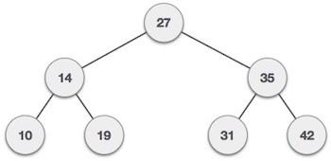
Introduction
A binary search tree (BST) follows:
The left sub-tree of a node has key less than or equal to its parent node's key.
The right sub-tree of a node has key greater than or equal to its parent node's key.

Slide 4
Introduction
The keys in a binary search tree are always stored in such a way as to satisfy the binary-search-tree property:
“Let x be a node in a binary search tree. If y is a node in the left sub-tree of x, then y.key ≤ x.key. If y is a node in the right sub-tree of x, then y.key ≥ x.key”.
Thus, in Figure (a), the key of the root is 6, the keys 2, 5, and 5 in its left subtree are no larger than 6, and the keys 7 and 8 in its right subtree are no smaller than 6. The same property holds for every node in the tree.

Slide 5
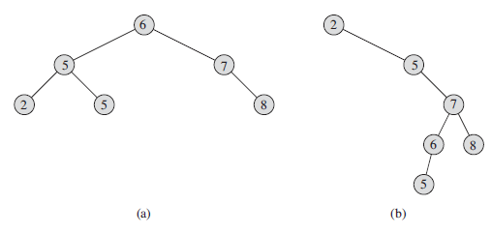
Introduction
Binary search trees. For any node x, the keys in the left sub-tree of x are at most x.key, and the keys in the right sub-tree of x are at least x.key.
Different binary search trees can represent the same set of values. The worst-case running time for most search-tree operations is proportional to the height of the tree. (a) A binary search tree on 6 nodes with height 2. (b) A less efficient binary search tree with height 4 that contains the same keys.

Slide 6
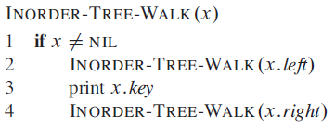
Introduction
The binary-search-tree property allows us to print out all the keys in a binary search tree in sorted order by a simple recursive algorithm, called an in order tree walk.
Each node contains attributes left, right, and p that point to the nodes corresponding to its left child, its right child, and its parent, respectively.

Slide 7
Introduction
As an example, the in order tree walk prints the keys in each of the two binary search trees from Figure in the order 2, 5, 5, 6, 7, 8.
It takes ‚ Θ(n) time to walk an n-node binary search tree, since after the initial call, the procedure calls itself recursively exactly twice for each node in the tree—once for its left child and once for its right child.

Slide 8
Querying a binary search tree
SEARCH operation,
MINIMUM,
MAXIMUM,
SUCCESSOR, and
PREDECESSOR.

Slide 9
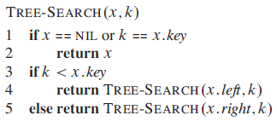
Searching in a BST
The following procedure to search for a node with a given key in a binary search tree. Given a pointer to the root of the tree and a key k, TREE-SEARCH returns a pointer to a node with key k if one exists; otherwise, it returns NIL.

Slide 10
Searching in a BST
The procedure begins its search at the root and traces a simple path downward in the tree, as shown in Figure (next slide).
For each node x it encounters, it compares the key k with x.key. If the two keys are equal, the search terminates.
If k is smaller than x.key, the search continues in the left sub-tree of x.
Symmetrically, if k is larger than x.key, the search continues in the right sub-tree.
The nodes encountered during the recursion form a simple path downward from the root of the tree, and thus the running time of TREE-SEARCH is O(h), where h is the height of the tree.

Slide 11
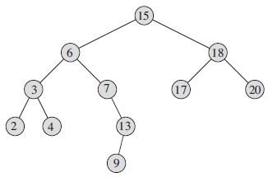
Searching in a BST
To search for the key 13 in the tree, we follow the path 15 →6 →7 →13 from the root. The minimum key in the tree is 2, which is found by following left pointers from the root. The maximum key 20 is found by following right pointers from the root. The successor of the node with key 15 is the node with key 17, since it is the minimum key in the right subtree of 15. The node with key 13 has no right subtree, and thus its successor is its lowest ancestor whose left child is also an ancestor. In this case, the node with key 15 is its successor.

Slide 12

Minimum and Maximum in BST
The following procedure returns a pointer to the minimum element in the sub-tree rooted at a given node x, which we assume to be non-NIL:

Slide 13
Minimum and Maximum in BST
If a node x has no left sub-tree, then since every key in the right sub-tree of x is at least as large as x.key, the minimum key in the sub-tree rooted at x is x.key.
If node x has a left sub-tree, then since no key in the right sub-tree is smaller than x.key and every key in the left sub-tree is not larger than x.key, the minimum key in the sub-tree rooted at x resides in the sub-tree rooted at x.left.

Slide 14
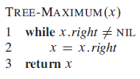
Minimum and Maximum in BST
The following procedure returns a pointer to the maximum element in the sub-tree rooted at a given node x, which we assume to be non-NIL:
Both of these procedures run in O(h) time on a tree of height h since, as in TREESEARCH, the sequence of nodes encountered forms a simple path downward from the root.

Slide 15
Successor and Predecessor in BST
Given a node in a binary search tree, sometimes we need to find its successor in the sorted order determined by an in-order tree walk.
If all keys are distinct, the successor of a node x is the node with the smallest key greater than x.key.

Slide 16
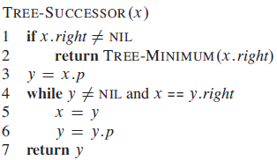
Successor and Predecessor in BST
The following procedure returns the successor of a node x in a binary search tree if it exists, and NIL if x has the largest key in the tree:

Slide 17
Successor and Predecessor in BST
We break the code for TREE-SUCCESSOR into two cases. If the right sub-tree of node x is nonempty, then the successor of x is just the leftmost node in x’s right sub-tree, which we find in line 2 by calling TREE-MINIMUM(x.right).
For example, the successor of the node with key 15 in Figure is the node with key 17.

Slide 18
Successor and Predecessor in BST
On the other hand, if the right sub-tree of node x is empty and x has a successor y, then y is the lowest ancestor of x whose left child is also an ancestor of x. In the figure, the successor of the node with key 13 is the node with key 15. To find y, we simply go up the tree from x until we encounter a node that is the left child of its parent; lines 3–7 of TREE-SUCCESSOR handle this case.

Slide 19
Successor and Predecessor in BST
The running time of TREE-SUCCESSOR on a tree of height h is O(h), since we either follow a simple path up the tree or follow a simple path down the tree. The procedure TREE-PREDECESSOR, which is symmetric to TREE-SUCCESSOR, also runs in time O(h).

Slide 20
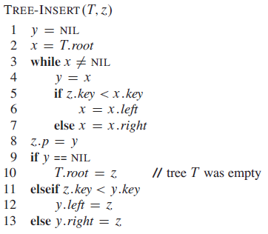
Insertion in BST
To insert a new value into a binary search tree T , we use the procedure TREE-INSERT.
The procedure takes a node z for which z.key=v , z.left =NIL, and z.right=NIL. It modifies T and some of the attributes of z in such a way that it inserts z into an appropriate position in the tree.

Slide 21
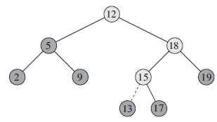
Insertion in BST
Inserting an item with key 13 into a binary search tree. Lightly shaded nodes indicate the simple path from the root down to the position where the item is inserted. The dashed line indicates the link in the tree that is added to insert the item.

Slide 22
Insertion in BST
Explanation:
TREE-INSERT begins at the root of the tree and the pointer x traces a simple path downward looking for a NIL to replace with the input item z. The procedure maintains the trailing pointer y as the parent of x.
After initialization, the while loop in lines 3–7 causes these two pointers to move down the tree, going left or right depending on the comparison of z.key with x.key, until x becomes NIL. This NIL occupies the position where we wish to place the input item z. We need the trailing pointer y, because by the time we find the NIL where z belongs, the search has proceeded one step beyond the node that needs to be changed. Lines 8–13 set the pointers that cause ’ to be inserted.

Slide 23
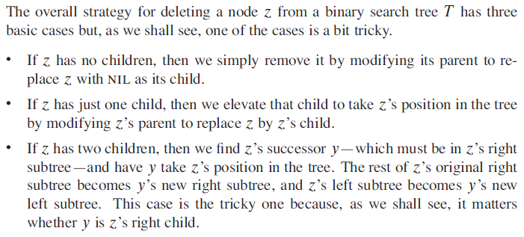
Deletion in BST

Slide 24
Deletion in BST
The procedure for deleting a given node ’ from a binary search tree T takes as arguments pointers to T and z. Consider the four cases to delete z.
Case 1:
If z has no left child (part (a) of the figure), then we replace z by its right child, which may or may not be NIL. When z’s right child is NIL, this case deals with the situation in which z has no children. When z’s right child is non-NIL, this case handles the situation in which z has just one child, which is its right child.

Slide 25
Deletion in BST
Case 2:
If z has just one child, which is its left child (part (b) of the figure), then we replace z by its left child.
Case 3 and 4:
Otherwise, z has both a left and a right child. We find z’s successor y, which lies in z’s right sub-tree and has no left child. We want to splice y out of its current location and have it replace ’ in the tree.
If y is z’s right child (part (c)), then we replace z by y, leaving y’s right child alone.
Otherwise, y lies within z’s right sub-tree but is not z’s right child (part (d)). In this case, we first replace y by its own right child, and then we replace z by y.

Slide 26
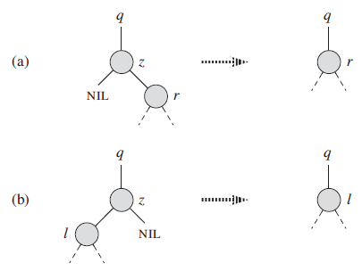
Deletion in BST

Slide 27
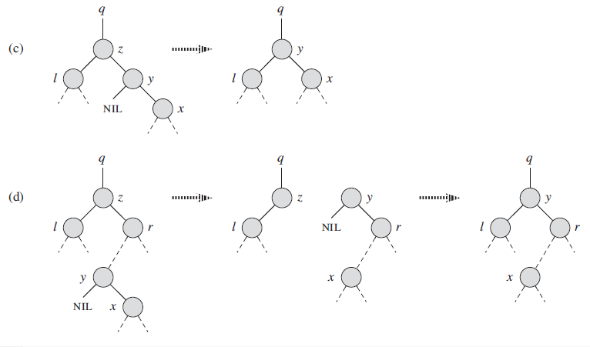
Deletion in BST

Slide 28
Deleting a node z from a binary search tree. Node z may be the root, a left child of node q, or a right child of q.
(a) Node z has no left child. We replace z by its right child r, which may or may not be NIL.
(b) Node z has a left child l but no right child. We replace z by l .
(c) Node z has two children; its left child is node l , its right child is its successor y, and y’s right child is node x. We replace z by y, updating y’s left child to become l, but leaving x as y’s right child.
(d) Node z has two children (left child l and right child r), and its successor y≠ r lies within the sub-tree rooted at r. We replace y by its own right child x, and we set y to be r’s parent. Then, we set y to be q’s child and the parent of l .

Slide 29
Binary Search Tree - Worst Time
Worst case running time is O(N)
What happens when you Insert elements in ascending order?
Insert: 2, 4, 6, 8, 10, 12 into an empty BST
Problem: Lack of “balance”:
compare depths of left and right sub-tree
Unbalanced degenerate tree

Slide 30
Balanced and unbalanced BST
1
4
2
2
5
3
1
3
4
4
Is this “balanced”?
5
2
6
6
1
3
5
7
7

Slide 31
Balancing Binary Search Trees
Many algorithms exist for keeping binary search trees balanced
Adelson-Velskii and Landis (AVL) trees (height-balanced trees)
Splay trees and other self-adjusting trees
B-trees and other multiway search trees

Slide 32
Perfect Balance
Want a complete tree after every operation
tree is full except possibly in the lower right
This is expensive
For example, insert 2 in the tree on the left and then rebuild as a complete tree
6
5
Insert 2 &
complete tree
4
9
2
8
1
5
8
1
4
6
9

Slide 33
AVL TREE
✔ An AVL tree is a balanced binary search tree. Named after their inventors, Adelson-Velskii and Landis
✔ They are not perfectly balanced, but pairs of sub-trees differ in height by at most 1, maintaining an O(logn) search time. Addition and deletion operations also take O(logn) time.
✔ An AVL tree is a binary search tree which has the following properties:
1. The sub-trees of every node differ in height by at most one.
2. Every sub-tree is an AVL tree.
✔What if the input to binary search tree comes in sorted (ascending or descending) manner?

Slide 34
AVL - Good but not Perfect Balance
AVL trees are height-balanced binary search trees
Balance factor of a node
height(left sub-tree) - height(right sub-tree)
An AVL tree has balance factor calculated at every node
For every node, heights of left and right sub-tree can differ by no more than 1
Store current heights in each node

Slide 35
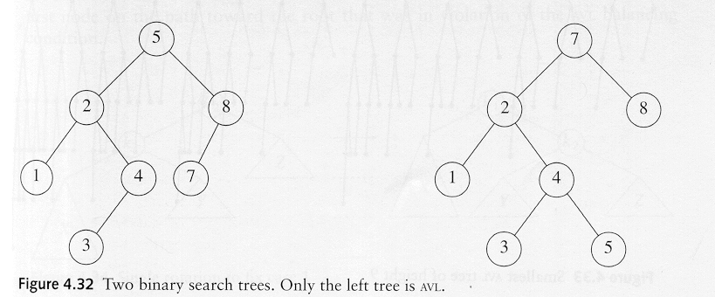
AVL - Good but not Perfect Balance
An AVL tree is a binary search tree in which
for every node in the tree, the height of the left and right subtrees differ by at most 1.
AVL property violated here

Slide 36
Insert and Rotation in AVL Trees
Insert operation may cause balance factor to become 2 or –2 for some node
only nodes on the path from insertion point to root node have possibly changed in height
So after the Insert, go back up to the root node by node, updating heights
If a new balance factor (the difference h_{left}-h_{right}) is 2 or –2, adjust tree by rotation around the node

Slide 37
Single Rotation in an AVL Tree
2
2
6
6
1
2
1
1
4
9
4
8
0
0
1
0
0
0
0
1
5
8
1
5
7
9
0
7

Slide 38
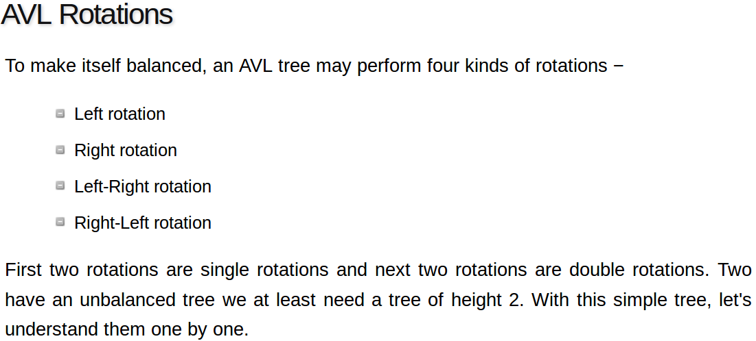
Single Rotation in an AVL Tree

Slide 39
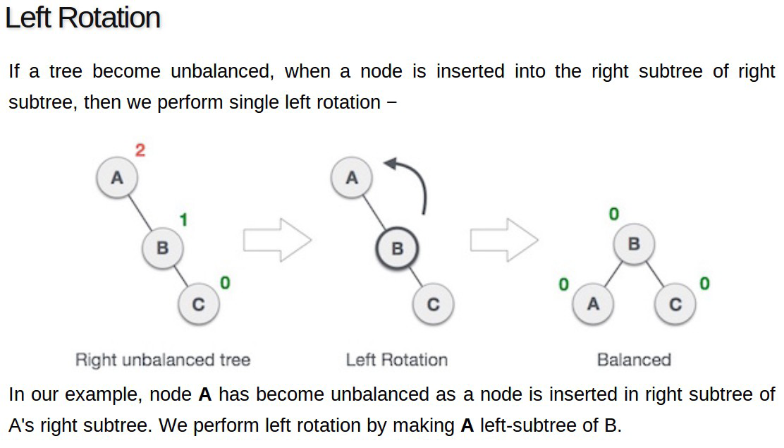
Single Rotation in an AVL Tree

Slide 40
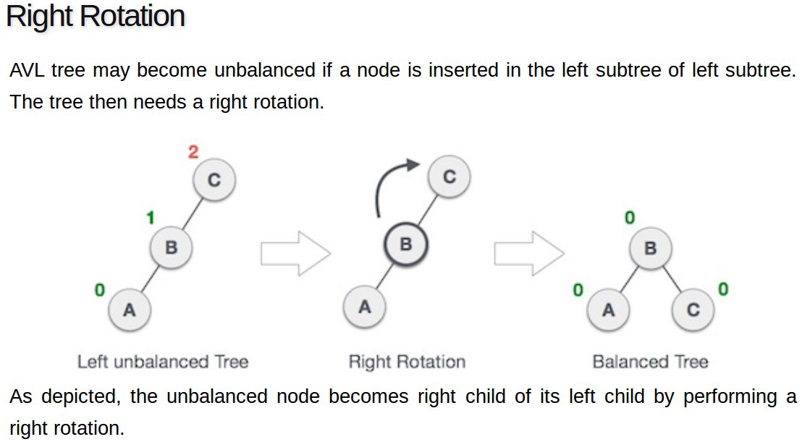
Single Rotation in an AVL Tree

Slide 41
Thank you

